Slide 1
TE&NE challenge
Team 17
Team member: Yuezhou Kang, Linjian Yang

Slide 2
Machine learning challenge
• Goal : Build a data-driven model to predict both compressional travel time (DT) and shear travel time (DTS) logs using least number of logs/inputs from the logging-while-drilling dataset.
• Problem Description:
Type: Supervised learning problem
Formulation: Predict sonic log through a non linear mapping between features
Inputs: Available well logs ( Porosity, Gamma Ray, Resistivity & Compressional slowness)
Output: DT and DTS

Slide 3
Data pre-processing
Identify outliers with the 13/5 Interquartile Rangers rule (More proper based on our model)
Fill Nan values with median in the test set. Though that will cause noise, compared with building other predictive model to fill the gap, the negative effect is less.
Based on statistical methods, most of the outliers has been removed. We then use isolation forest to gently remove some outliers near the boundary to ensure the stability and standardization of the dataset.
Draw a distribution plot to visualize the processed data set and observe whether each feature conforms to the normal distribution.
Use Pearson and Spearman correlation method to select features and rank the relevance of features to prepare for modeling.
Notes:
用其他变量做预测模型来算出缺失变量 效果比方法1略好 有一个根本缺陷,如果其他变量和缺失变量无关,则预测的结果无意义 如果预测结果相当准确,则又说明这个变量是没必要加入建模的

Slide 4
Methodology and improvement
Try Decision Tree, Random Forest, and xgbooster gradient boosting, and compared their corresponding accuracy.
Xgbooster gradient Boosting > Random Tree > Decision Tree
Hyperparameter Optimization (The Best could be 98! )
Cross-validation + Comparison of accuracy curves between test group and training group --- The purpose is to determine whether the forecast curve has a trend of overfitting or underfitting
Improvement: In the process of data preprocessing, the most accurate way is to map variables to high-dimensional space. The advantage is that all the information of the original data is completely retained, without considering missing values, without considering issues such as linear inseparability.

Slide 5
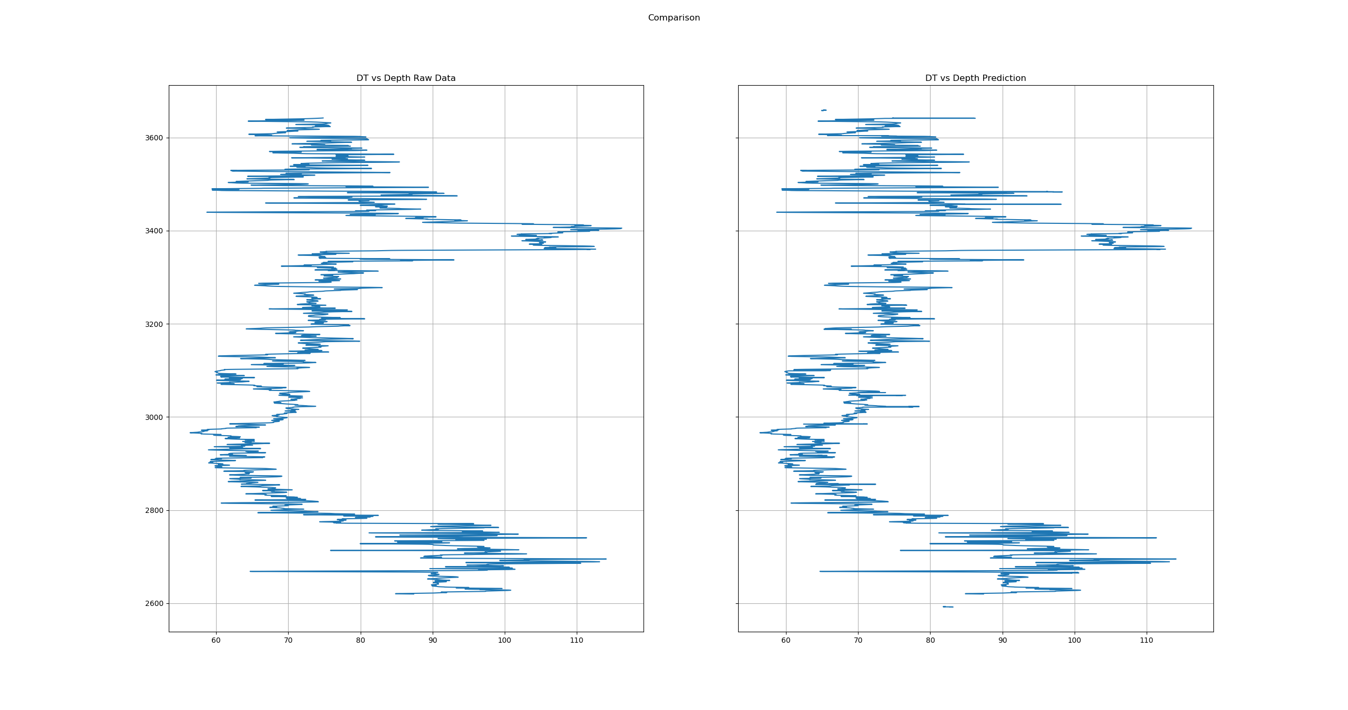
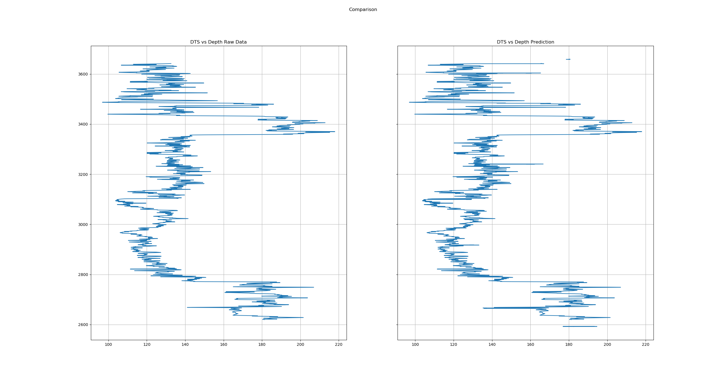
Visualization

Slide 6

Executed Python file
Install Python environment 3.7 or above
Require “Problem 2 Dataset (Clean).xlsx” only
Output is on file “Prediction Data.xlsx”
THANKS FOR SUPPORTING!
GIG’ EM

